Slide 1
AllHands
Proactive Prevention to Keep You Safe

Slide 2
AllHands provides proactive prevention and immediate, efficient support for potential or actual unsafe situations.

Slide 3
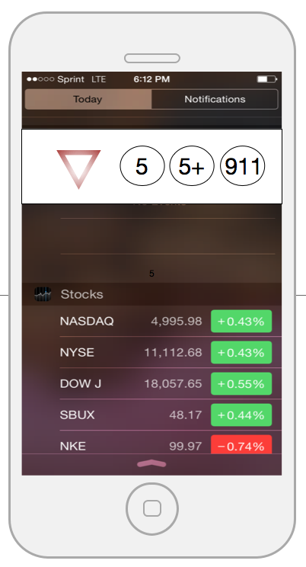

Slide 4
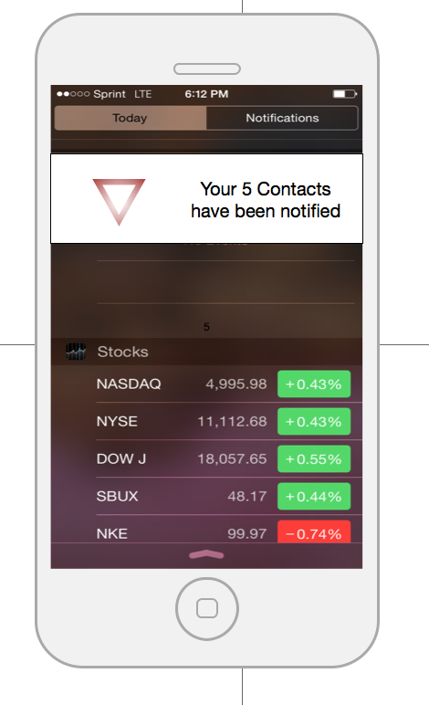

Slide 5
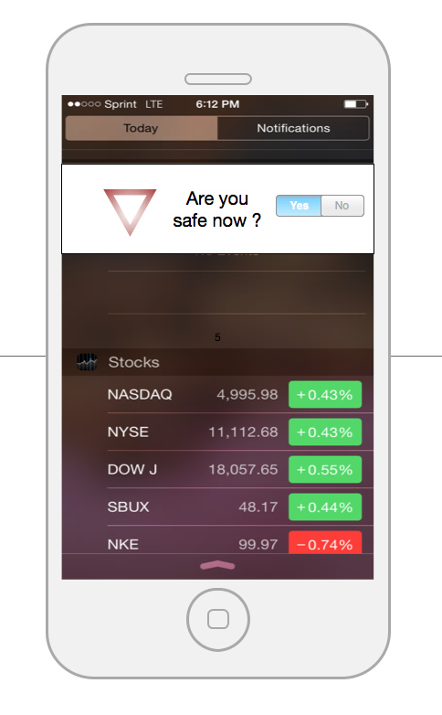

Slide 6
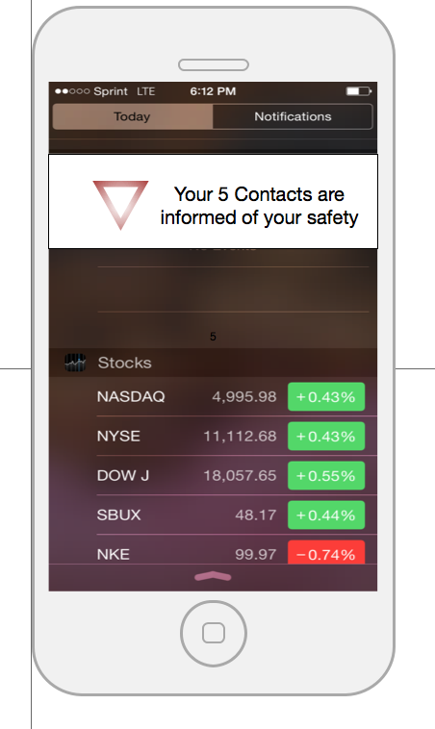

Slide 7
AllHands 3 Tiers
ALL 5
Notify ALL 5 of your location
5+
2nd notification to ALL 5
Audio & video activated
CALL 911

Slide 8
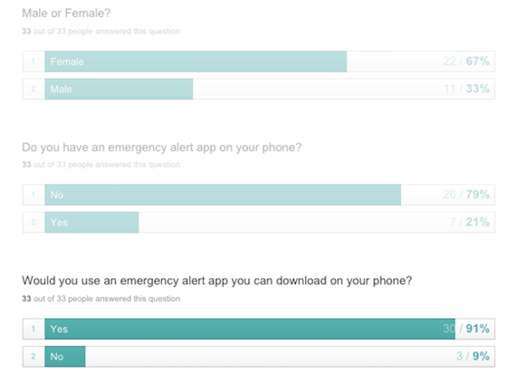
Is it necessary?

Slide 9
AllHands is scalable and global
Wearables
Voice recognition
Partnership with cell phone manufacturers

